Slide 1
Microsoft Intune Webinar
– Michael Coyle April 8th

Slide 2
Microsoft Intune
History
Microsoft Intune is a cloud-based enterprise mobility management tool that aims to help organisations manage the mobile devices employees use to access corporate data and applications, such as email.
Microsoft Intune launched in 2011 as Windows Intune. The name change to Microsoft Intune was announced in 2014.

Slide 3
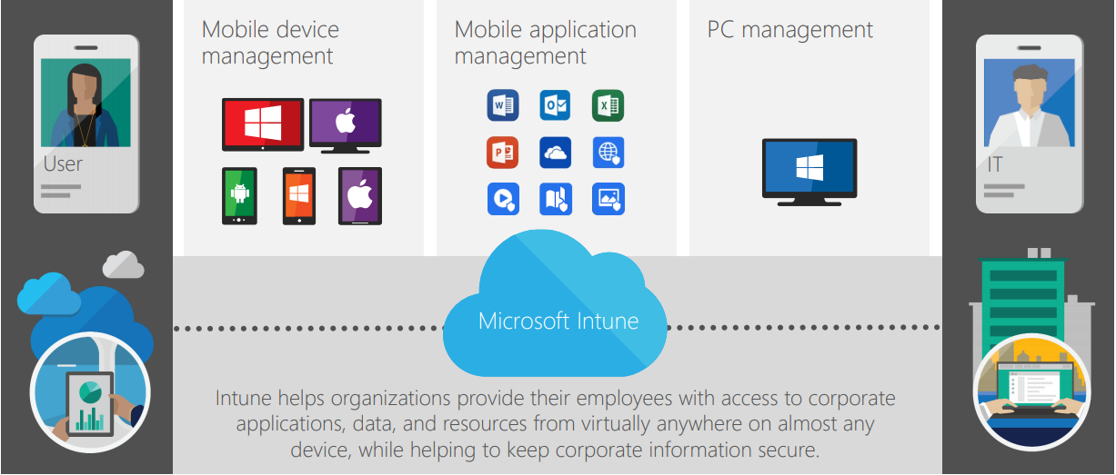
Microsoft Intune
A Basic Overview

Slide 4
Microsoft Intune
A Basic Overview
Three elements:
PC Management
Mobile Device Management (MDM)
Mobile Application Management (MAM)
“Mobile” does not mean mobile phone. It means “portable”
Manage devices and applications on the following platforms:
Windows 8.1 and Windows 10
iOS
Android
macOS
Management of Windows 7 devices is only through the classic (Silverlight) Intune portal. This is now deprecated by Microsoft

Slide 5
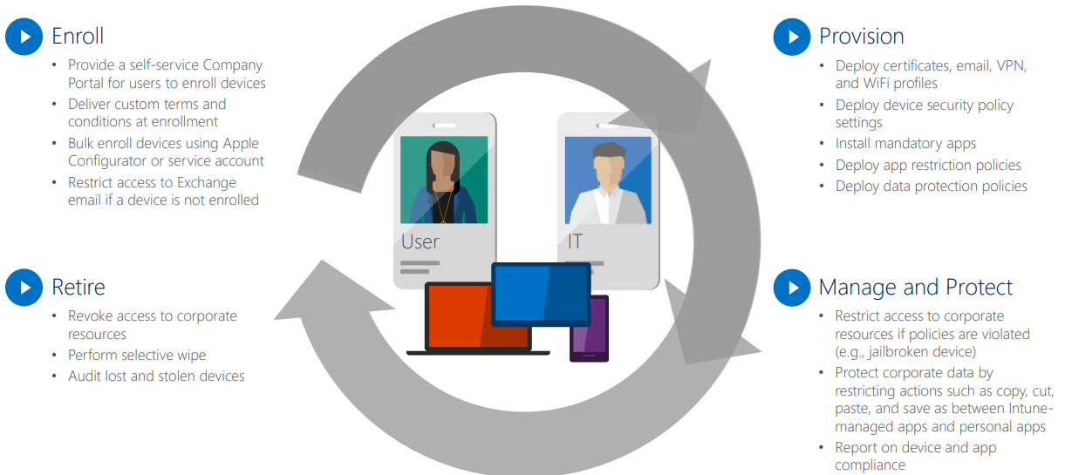
Microsoft Intune
Lifecycle Management

Slide 6
Microsoft Intune
Common Uses
Enforcing security settings on devices
Passwords, encryption etc.
Ensuring compliance of devices
Are devices still encrypted, password protected, checking in regularly…..
Deploying new applications to devices
Securing data within applications on devices

Slide 7
Intune
Best Practices
Should be sold as a managed service
Not a once off deployment project
Should be managed and monitored continuously for compliance
This is how you justify the ongoing monthly license fee to the customer and explain the implications if they want to remove it
Start simple and build it out
Complex deployments will upset customers if they are accidently blocked
Use the product internally in your organisation
This is the best way to learn
You may have internal usage rights for EM+S

Slide 8
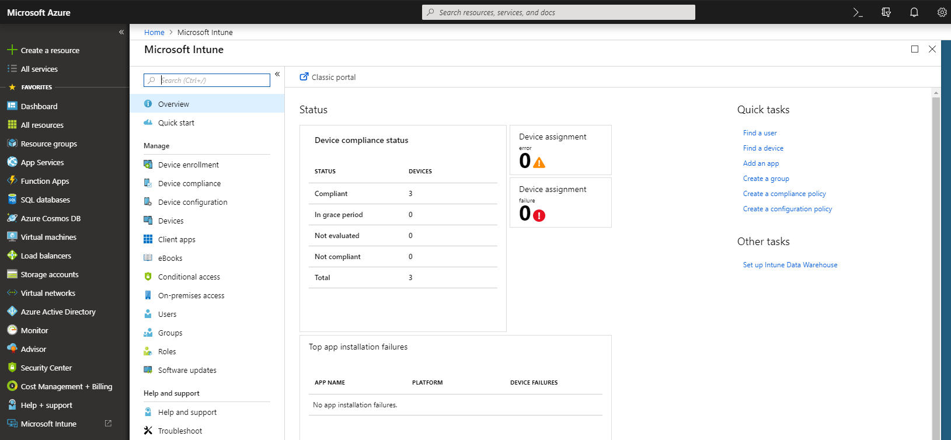
Microsoft Intune
A Basic Overview of Mobile Device Management
Managed through same portal as Azure
Device Management Consists of:
Device Configuration Profiles
Device Compliance Policies
Both need to be assigned to users or devices before they take effect
Intune needs to be set as the MDM Authority not O365 MDM
Check at https://admin.microsoft.com/EAdmin/Device/IntuneInventory.aspx

Slide 9
Microsoft Intune
Device Enrolment
Organisation specific settings need to be configured for the platform of the devices to be enrolled.
iOS devices need an Apple MDM Push certificate assigned
Android devices can be linked to a Managed Google Play account
Windows 10 devices can be associated with Windows Store

Slide 10
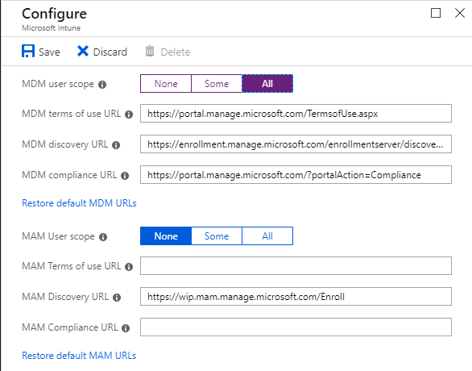
Microsoft Intune
Windows 10 Auto-enrolment
Windows 10 devices can be auto-enrolled to Intune
If your users have Azure AD Premium P1 licensing
1. By using Windows Autopilot to deploy via Azure AD
or
2. By Group Policy for domain joined devices
AND they are on build version 1709 or higher

Slide 11
Microsoft Intune
iOS Enrolment
Apple MDM Push Certificate must be installed in Intune portal
Requires Apple ID
Enrolment Options:
Manual Enrolment (BYOD)
Apple's Device Enrolment Program (DEP)
Apple School Manager
Apple Configurator
Must install Intune Company Portal App from Apple Store (if user affinity required)
Requires an Apple ID

Slide 12
Microsoft Intune
macOS Enrolment
Apple MDM Push Certificate must be installed in Intune portal
Enrolment Options:
Apple's Device Enrolment Program (DEP)
Apple's Device Enrolment Manager (DEM)
Manual Enrolment (BYOD)
Must install Intune Company Portal App from Apple Store
Requires an Apple ID

Slide 13
Microsoft Intune
Configuration Profiles
Configuration profiles are used to push settings to devices
Examples of some device configurations are:
Device Restrictions
Password Policies
Encryption Settings
Email / WiFi / VPN Profiles
Administrative Templates (Preview) – similar to group policy
Custom (OMA-URI) – custom administrative templates
Local Security Policy Settings
Registry Settings

Slide 14
Microsoft Intune
Compliance Policies
Compliance policies are a set of defined rules that the device must follow
Examples of some device compliance rules are:
Is the device OS version still supported in the organisation?
Has the device OS been jailbroken?
Is the device encrypted?
Are the password / security settings compliant with company policy?
Is the device Antivirus and Firewall turned on?

Slide 15
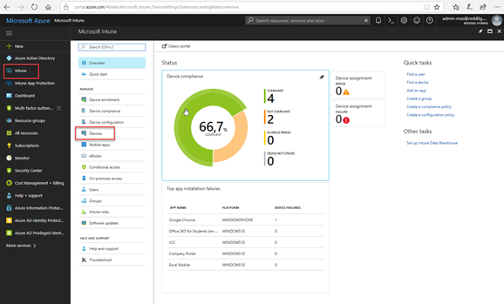
Microsoft Intune
Monitoring Compliance
Device compliance can be monitored through the monitoring dashboards of the Intune portal
Data can be exported to CSV file
Notification email alerts can be triggered if a device falls out of compliance

Slide 16
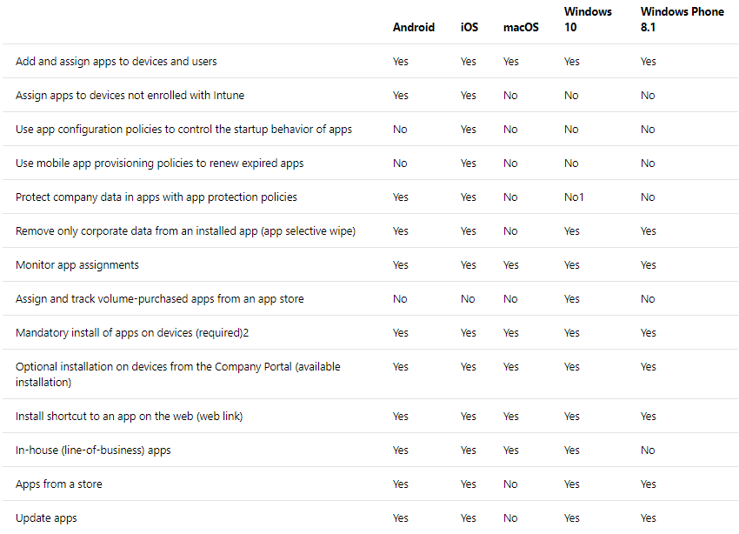
Microsoft Intune
Intune App Management Capabilities

Slide 17
Microsoft Intune
A Basic Overview of Mobile Application Management
Mobile Application Management Consists of:
App Configuration Policies
Used for more advanced setups to apply configuration settings within the app
Example: Disable email notifications in Outlook app
App Protection Policies
Used to apply restrictions within the app
Example: Prevent data from Outlook app being copied to other apps
Devices do not have to be enrolled/managed by Intune in order to protect apps however they do need the Intune app installed. This is intended to facilitate BYOD devices that may not belong to the organisation

Slide 18
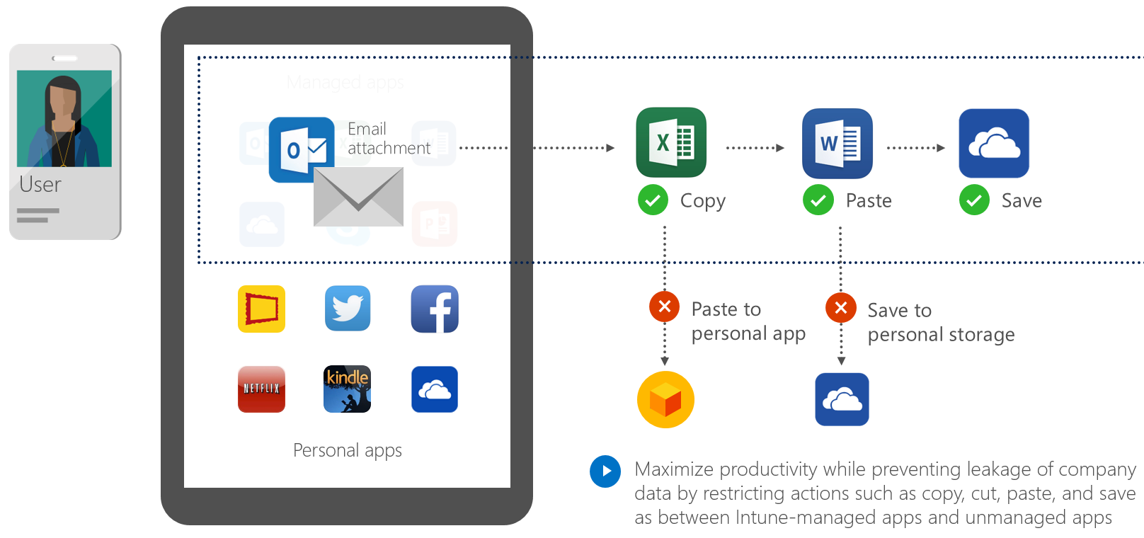
Microsoft Intune
A Basic Overview of Mobile Application Management

Slide 19
Windows Autopilot
Windows 10 Deployment with Windows Autopilot
Create a Windows Autopilot deployment profile
This essentially enables the device to join to your Azure AD tenant automatically
Support for automated Hybrid Azure domain in preview now (needs build 1809)
Import devices to Windows Autopilot
Details harvested from devices via PowerShell Script
Can be compiled into a CSV file
This step can be performed by some hardware vendors for new devices
Associate device with Windows Autopilot deployment profile
Optionally associate device with Azure AD User for more personalised experience

Slide 20
Windows Autopilot
Windows 10 Deployment with Windows Autopilot
Device IDs
Windows Autopilot
Autopilot profile sync
Intune
Device sync
Configure Windows Autopilot profile
Self-service deploy
IT Admin
Hardware Vendor
Ship
Deliver direct to Employee
Employee unboxes device, self-deploys

Slide 21
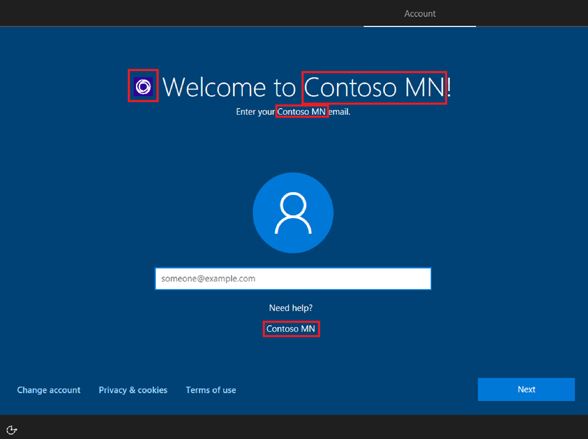
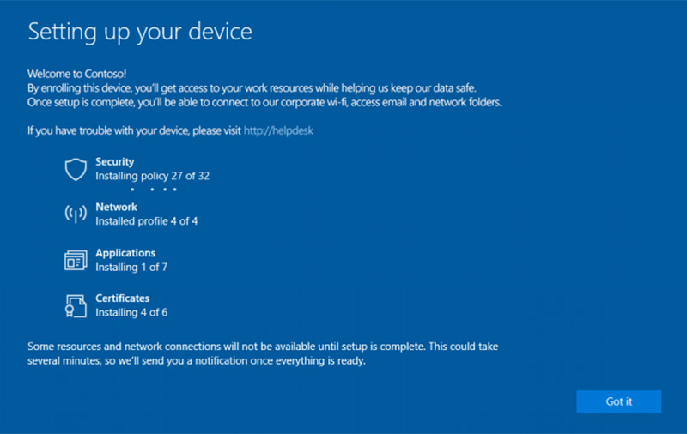
Windows Autopilot
Windows 10 Deployment with Windows Autopilot

Slide 22
Licensing
Licensing options for Intune
Microsoft Intune (Standalone)
Microsoft Intune Device
Enterprise Mobility & Security E3
Enterprise Mobility & Security E5
Microsoft 365 Business
Microsoft 365 F1
Microsoft 365 E3
Microsoft 365 E5
Microsoft 365 A1
Microsoft 365 A3
Microsoft 365 A5
https://docs.microsoft.com/en-ie/intune/licenses

Slide 23
MDM Competitors
Alternatives to Intune
MobileIron
AirWatch (VMware)
MaaS360 (IBM)
XenMobile (Citrix)

Slide 24
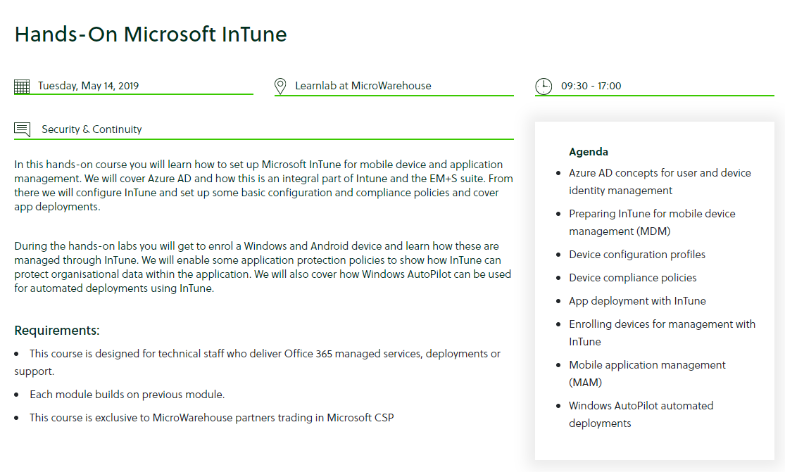
Technical Training
https://www.mwh.ie/learn/

Slide 25
Q and A

