Slide 1
Windows 2008/R2 &
SQL Server 2008/R2
End of Support
Alan Kinane
Azure Technical Lead, MicroWarehouse

Slide 2

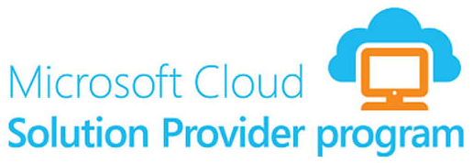





About MicroWarehouse
Value added distributor
Irish owned/located distributor
  Park West, Dublin 12, Ireland
Distributors for:
  Microsoft on-premises & cloud
  Microsoft Surface
  Veeam
  SkyKick for Office 365 backup
  DataOn for Storage Spaces
  And many more
Value added distribution:
  Much more than selling licenses
  Cloud aggregation
  Get your licensing right
  Sales education
  Technical training
@MWHDistribution

Slide 3
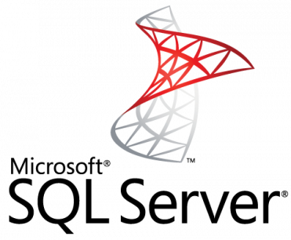
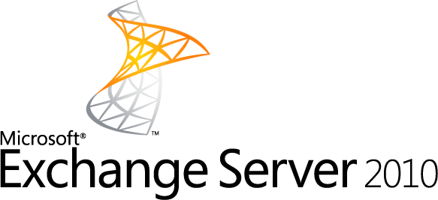
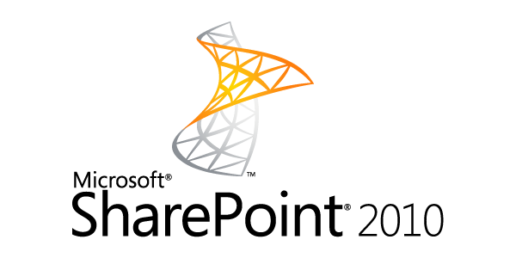
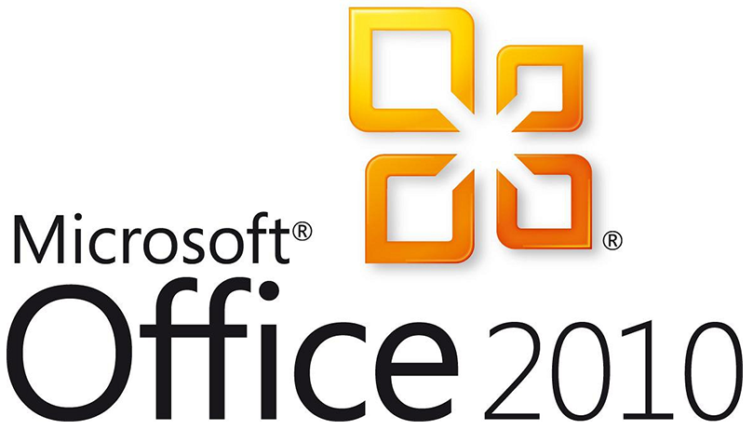
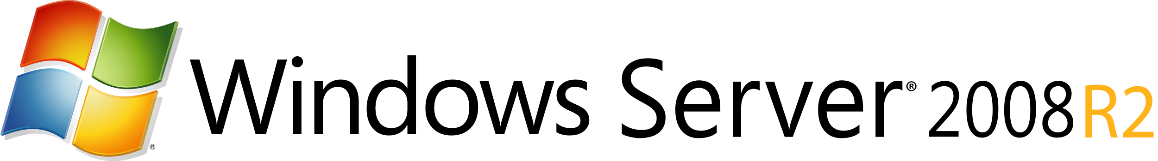
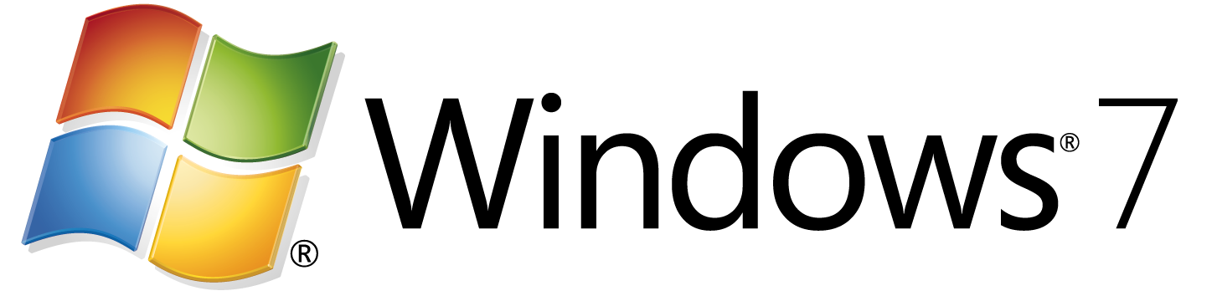
End of support for other products: know your options
End of support means security updates are no longer provided. We have options to upgrade across cloud and on-premises.
For more information, visit www.microsoft.com/lifecycle.
2008 and 2008
R2
2008 and 2008
R2
Extended
support ends
July 9, 2019 | January 14, 2020 | January 14, 2020 | January 14, 2020 | October 13, 2020 | October 13, 2020
Move applications to Azure SQL DB Managed Instance or SQL Server 2017/2019 on Azure VMs or on-premises | Migrate applications to Azure 2008/R2 Virtual Machines and get 3 more years of free extended security updates. Upgrade when ready | Migrate to Exchange Online/Office 365 ​ | Shift to a modern desktop with Windows 10 and Office 365 ProPlus | Migrate to SharePoint Online/Office 365
Recommended
action
Migrate to Azure 2008/R2 Virtual Machines and get 3 more years of free extended security updates. Upgrade when ready | Upgrade on-premises to Windows Server 2016 or 2019 | Upgrade on-premises to Exchange Server 2016​ | Migrate to Windows Virtual Desktop in Azure and get free extended security updates for 3 more years | Migrate to Office 2019 | Upgrade to SharePoint Server 2019
Fallback
option
Last resort
option
Buy extended security updates for on-premises servers desktops | Upgrade on-premises to Exchange Server 2013 | Buy extended security updates for on-premises desktops | Migrate to a supported version of Office | Upgrade to SharePoint Server 2013
Notes:
Many Microsoft customers will soon face End of Support transitions for a number of popular Microsoft products.
This slide includes high-level options across both cloud and on-premises. End of support is a good time to reassess and consider the benefits of cloud-based solutions.
Some products also offer Extended Security Updates to help customers keep workloads protected if they cannot upgrade before the deadline.
Official End of Support deadlines for all Microsoft products can be found at support.microsoft.com/lifecycle/

Slide 4
Deadline to act before end of support
Impact of end of support
No security updates
SQL Server 2008 and 2008 R2
Extended Support
ends July 9, 2019
Compliance concerns
Windows Server 2008 and 2008 R2
Extended Support
ends January 14, 2020
Missed innovation opportunities
2018
2019
2020
Find lifecycle support deadlines at: support.microsoft.com/lifecycle
Notes:
For Windows Server 2008 and Windows Server 2008 R2, end-of-life mainstream support ended January 14, 2015—and Microsoft ends Extended Support on January 14, 2020.
Likewise, Extended Support for SQL Server 2008 and 2008 R2 ends July 9, 2019. The database is often tied to one or more applications running on Windows Server, so it makes sense to look at both as you build your EOS plan.
Many organizations are running workloads on Windows Server 2008 and 2008 R2. You can continue to use Windows Server 2008 R2 safely in your environment’s architecture, at least until the extended support expiration date.
If you put off action, however, you miss out on new security and efficiency features that could easily justify a move – either to Azure or Windows Server 2016. Take the time to assess your options and make decisions that are right for your organization. With the right strategies, you can make sure your organization is protected and your infrastructure secure.

Slide 5
Overview of server product lifecycle
End of support means the end of security updates
Product release
End of support
Examples of recent “critical” and
“important” security updates
Mainstream Support
5 years
Extended Support
5 years
Event/Incident | Severity/Impact
Petya | Critical/Remote Code Execution
Meltdown/ Spectre (Speculative Execution Side Channel Attacks) | Important/ Information Disclosure
New features
Security updates
Non-security updates
Security updates
Non-security updates
Find lifecycle support deadlines at: support.microsoft.com/lifecycle
Notes:
If you’re running Windows Server or SQL Server 2008 or 2008 R2, these versions are reaching the end of their support lifecycle. Each version is backed by a minimum of 10 years of support (5 years for Mainstream Support and 5 years for Extended Support) including regular security updates. End of support means the end of security updates, which can cause security and compliance issues and put applications and business at risk. We recommend upgrading to current versions for the most advanced security, performance, and innovation. To help customers that can’t get it all upgraded by the deadline, new options help you protect applications and data during the upgrade transition.
Here are a few examples of security updates Microsoft has released recently to address vulnerabilities exploited by attacks. More information is here https://portal.msrc.microsoft.com
More info on WannaCrypt
https://blogs.technet.microsoft.com/msrc/2017/05/12/customer-guidance-for-wannacrypt-attacks/
More info on Meltdown/Spectre
https://portal.msrc.microsoft.com/en-US/security-guidance/advisory/ADV180002

Slide 6




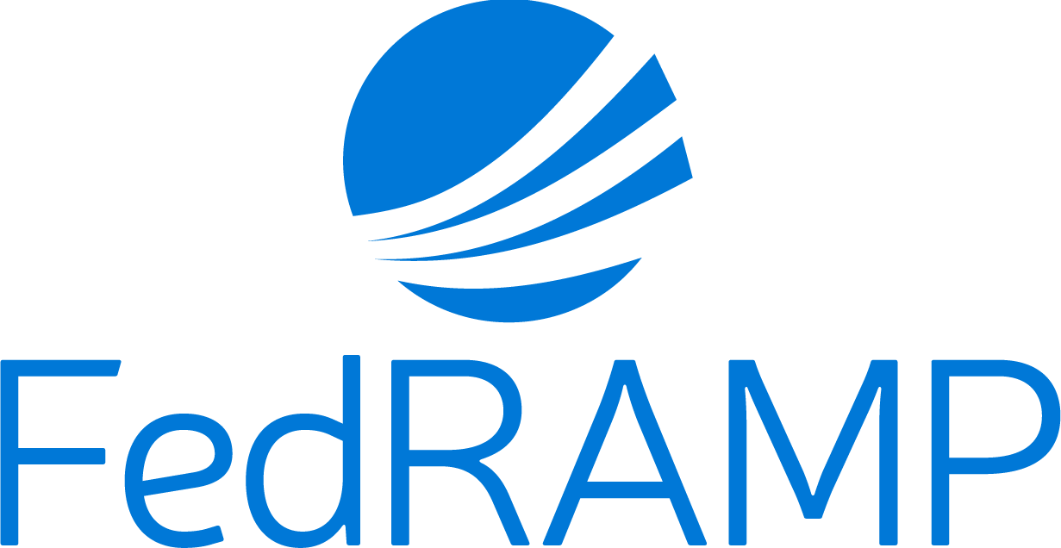

Security updates are mission critical in today’s world
4.2B
records stolen by hackers in 2016
20%
of organizations lose customers during an attack
30%
of organizations lose revenue during an attack
GDPR
New requirements
May 25, 2018
Other regulations for protecting data
Sources: Risk Based Security Report, 2017; Cisco 2017 Annual Cybersecurity Report; Juniper Research Cybercrime & The Internet of Threats, 2017

Slide 7
Extended security updates for
2008 and 2008 R2—free in Azure
IaaS: Move to Azure VMs, get 3 more years of extended security updates at no additional charge
PaaS: Move SQL Server to Azure SQL Database Managed Instance (version free, fully managed, no patching needed)
Use Azure Hybrid Benefit to maximize on-premises investments
Migrate to Azure
SQL Server
2008 and 2008 R2
Extended support
ends July 9, 2019
Windows Server
2008 and 2008 R2
Extended support
ends January 14, 2020
Upgrade to current Windows Server/ SQL Server versions
OR
Buy 3 more years of extended security updates on 2008/2008 R2
2018
2019
2020
Stay on-premises
Notes:
Alternative slide for EOS options.
Are you still running a lot 2008 and 2008 R2 workloads? End of support is coming soon!
We are pleased to announce new options to keep workloads protected if you can’t get it all upgraded in time for the deadline.
In Azure:
If Azure is your destination, you can simply migrate apps running on Windows Server 2008/2008 R2 as is – and get three more years of security updates for free. This buys you more time to work on upgrading or modernizing your applications in the cloud.
Many apps are tied to data, so we will also offer 3 years of free Extended Security Updates for SQL Server 2008/2008 R2 running in Azure VMs. Or, even better, migrate to Azure SQL Database Managed Instance for a version-free option that will make this your last end-of-support transition.
On-premises:
We recommend upgrading to the most current versions of Windows Server and SQL Server. If you cannot meet the deadline, you can buy Extended Security Updates to keep the remaining servers protected until you get them upgraded.

Slide 8
Weighing your options
Is it time to move to the cloud?
Migrate to Azure
Upgrade on-premises
Rehost
Migrate Windows Server 2008
and 2008 R2 workloads to
Azure VM
Refactor, Rearchitect,
or Rebuild
Innovate with Windows
Server containers and Azure services
Upgrade
Upgrade to Windows Server 2016 and get cloud and DevOps ready
Notes:
Organizations have options. You may use multiple options to move workloads from Windows Server 2008/2008 R2, depending on the workload.
Do you want to keep the workload on-premises or move to the cloud?
Can you upgrade the operating system?
Do you want rebuild the application using new app patterns with Azure PaaS – or simplify containerize to lift and shift with minimal code changes?
Microsoft has you covered across all options:
Move to Azure by choosing to Rehost, Refactor, or Rebuild your workload or app.
Or Upgrade on premises to the latest version of Windows Server.

Slide 9
Paths to upgrade and stay protected
  Migrate to Azure
  Upgrade on-premises
Migrate applications to Azure VMs
Get free extended security updates for Windows Server 2008 and 2008 R2 VM’s for three years after deadline
Migrate data to Azure Managed Instances or VMs
Azure SQL Database Managed Instance offers
a version-free option
Get free extended security updates for
SQL Server 2008 and 2008 R2 in Azure VM’s
for three years after the deadline
Modernize when ready
Upgrade in Azure when ready
Transform apps and data with Azure services
Upgrade to latest version
Windows Server 2016 or 2019
SQL Server 2017
Can’t meet the deadline? Protect server workloads
Buy extended security updates to get 3 more years
of security updates for Windows Server and
SQL Server 2008 or 2008 R2
Upgrade when ready
OR
Notes:
We are pleased to announce new options to keep workloads protected if you can’t get it all upgraded in time for the deadline.
In Azure:
If Azure is your destination, you can simply migrate apps running on 2008/2008 R2 as is – and get three more years of security updates for free. This buys you more time to work on upgrading or modernizing your applications in the cloud.
Many apps are tied to data, so we will also offer 3 years of free Extended Security Updates for SQL Server 2008/2008 R2 running in Azure VMs. Or, even better, migrate to Azure SQL Database Managed Instance for a version-free option that will make this your last end-of-support transition.
On-premises:
We recommend upgrading to the most current versions of Windows Server and SQL Server. If you cannot meet the deadline, you can buy Extended Security Updates to keep the remaining servers protected until you get them upgraded.

Slide 10
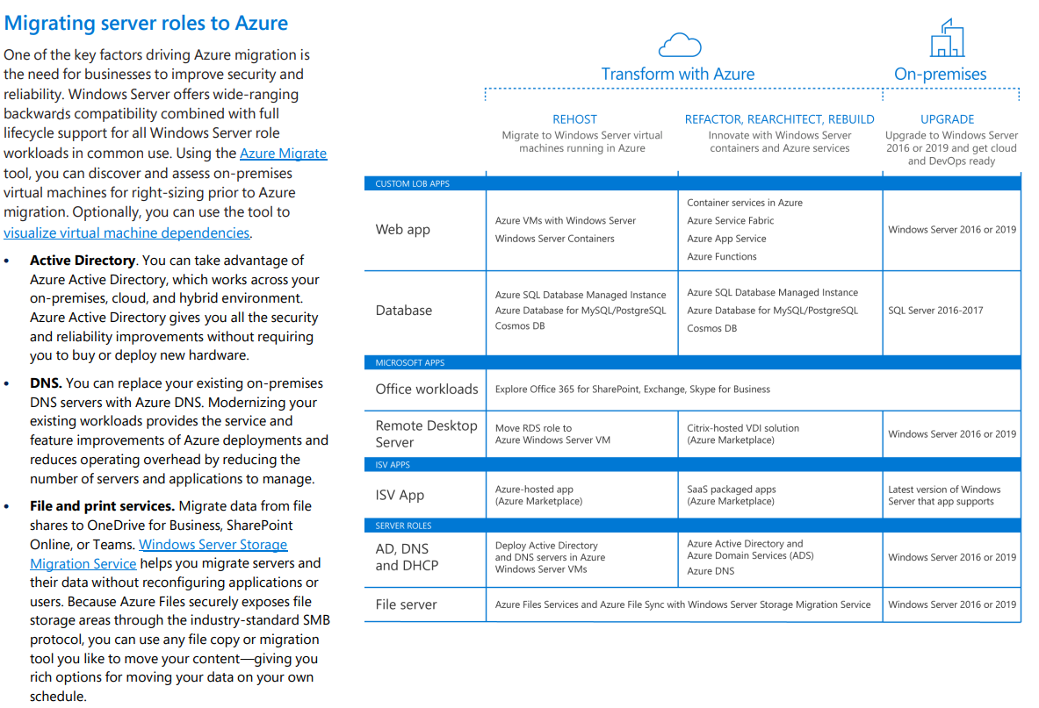

Slide 11

3 reasons to migrate 2008 server applications to Azure now
Use cloud innovation to retire technical debt
Realize significant cost savings vs. on-premises
Improve security
and compliance
Azure IaaS
Azure SQL Database
Azure App Service
Azure Hybrid Benefit
Free extended security updates
Infrastructure optimization
Secure cloud foundation
Built-in, multi-layered security controls
More certifications
than other providers
Notes:
3 key reasons for you to migrate 2008 servers to Azure now:
Security and Compliance: Migrating your applications to Azure enables you to strengthen your security posture and consistently meet compliance requirements. Our secure cloud foundation will help you effectively counter sophisticated security threats. Check out this EOS Security Risk datasheet to learn more.
Save money: Save with free extended security updates, Azure Hybrid Benefit, and optimized infrastructure. For example, moving 100 End of Support servers to Azure can save customers over $750K over 3 years vs. running them on-premises (source: Azure TCO calculator). Sample report.
Innovation: As you migrate you can embrace the innovation available in Azure to modernize your applications. You can focus on business innovation with fully-managed services such as Azure SQL Database, Azure App Service, and Azure IaaS.

Slide 12
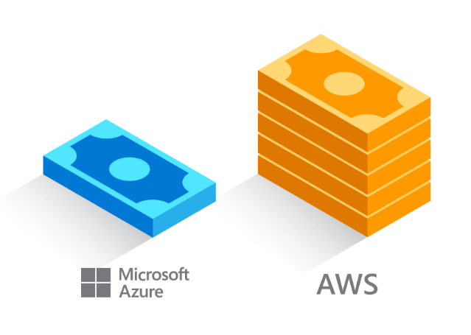


Azure is the most cost-effective cloud for Windows Server
Get free extended security updates for Windows Server 2008/2008 R2 for three more years
Save with Azure Hybrid Benefit, an Azure-only benefit for customers with active SA or subscription licenses
Use existing licenses and pay only the “base rate” on Azure Virtual Machines (IaaS)
Run Datacenter edition on-premises and save on up to 2 VMs and up to 16 cores in Azure
AWS is 5x more expensive than Azure
Learn more at: http://aka.ms/Why5xmore
Move Standard edition licenses and save on up to 2 VMs and up to 16 cores in Azure
Significantly reduce the costs of migrating to the cloud
Notes:
Azure is the most cost-effective cloud for Windows Server workloads.
If you already own Windows Server licenses with Software Assurance, you can use the value of those licenses to save on Azure virtual machines using the Azure Hybrid Benefit. For the Standard edition, you will move the use of those licenses to Azure. For the Datacenter edition, you can continue to use the licenses both on-premises and in Azure. This benefit is only available with Azure, which means you will repurchase Windows Server licenses when you choose other clouds.
Also available only on Azure: FREE extended security updates for Windows Server 2008/R2. This gets you three more years of security updates while you work on upgrading, refactoring or retiring your app.

Slide 13

Azure is the most cost-effective cloud for SQL Server
Azure Hybrid Benefit, an Azure-only benefit for customers with active SA or subscriptions on SQL Server cores
Significantly reduce the costs of migrating to the cloud
Pay only the ‘base rate’ in Azure on SQL Server on Azure VM (IaaS), Azure SQL Database (Paas), and ADF v2 SSIS
Available for SQL Server core licenses only
Customers can use on premises cores or cloud vCores
AWS is 5x more expensive than Azure
Learn more at: http://aka.ms/Why5xmore
Cores can be used on-premises and in Azure simultaneously for up to 180 days, to allow for migration
Notes:
The Azure Hybrid Benefit helps maximize your existing investments in on-premises licenses with discounted rates on SQL Database.
*Note that the Azure Hybrid Benefit for SQL is an Azure benefit for customers with active Software Assurance (including subscription licensing) on their SQL cores.
Customers can use their licenses on premises, or as vCores towards eligible Azure data services.
By using this benefit, the customer is charged the ‘base rate’ in Azure, which excludes the charges. The ‘base rate’ is the cost of compute, storage, backup, and any I/O charges that may apply. SQL license costs are waived.
*Calculations based on scenarios running 744 hours/month for 12 months at 3-year Reserved Capacity. Prices as of 10/24/2018, subject to change. SQL Server calculations based on 8 vCore Azure SQL Database Managed Instance Business Critical in US West 2 running at Azure Hybrid Benefit rate. AWS calculations based on RDS for SQL EE for db.r4.2xlarge on US West (Oregon) in a multi AZ deployment for Reserved Instances under Standard 3-year term, all upfront payment. Extended security updates cost used for AWS is based on Windows Server Standard open NL ERP pricing in USD. Actual savings may vary based on region, instance size, and performance tier. Savings exclude Software Assurance costs, which may vary based on Volume Licensing agreement. Contact your sales representative for details.

Slide 14
Save big on Windows Server workloads in Azure
Cost
Pay-as-you-go
Save big
Save even more
$$$
49%
80%
$$
$
Azure Hybrid Benefit
for Windows Server
vs. pay-as-you-go
Azure Hybrid Benefit
for Windows Server +
Azure Reserved Instances
3-year savings vs. pay-as-you-go
Disclaimers
The 80% saving is based on the combination of Windows Server Azure Hybrid Benefit and 3-year Azure Reserved Instances.
The cost does not include Software Assurance cost.
Sample annual cost comparison of two D2V3 Windows Server VMs. Savings based two D2V3 VMs in US West 2 Region running 744 hours/month for 12 months; Reduced compute rate at SUSE Linux Enterprise rate for US West 2. Azure pricing as of 04/24/2018. AWS pricing as of 04/24.2018. Price subject to change.
Actual savings may vary based on location, instance type, or usage.
Notes:
It’s easier to support hybrid environments when your server licenses can transfer seamlessly— and cost-effectively—between on-premises and cloud deployments. The Azure Hybrid Benefit gives organizations the ability to use on-premises Windows Server licenses with Software Assurance (SA) and pay reduced VM rates.
This gives organizations flexibility to transition to the cloud at their own pace in a very cost-effective manner.
Save up to 49% on Windows Server virtual machines with Azure Hybrid Benefit for Windows Server. Maximize your investment in Windows Server software
Combine with Azure Reserved Instances to save up to 80 percent. Reduce your total cost of ownership even more when you reserve Windows virtual machines on Azure for one-year or three-year. Reserved instances can help you manage costs across predictable and variable workloads.

Slide 15
Get started
Assess
Inventory Windows Server 2008 and 2008 R2 workloads in your environment and determine migration path.
Migrate
Upgrade to Windows Server 2016 or migrate to Azure with guidance, resources and tools.
Optimize
Use Azure hybrid services to manage cost and resources, and strengthen security and compliance across your hybrid cloud workloads.
Visit the Microsoft End of Support resource center at:
www.Microsoft.com/2008-eos
Notes:
By breaking down the migration process into three steps—Assess, Migrate, and Optimize—you can solve the most pressing migration challenges and deliver the reliability, performance, and security your business stakeholders expect.
Your approach depends on what your IT infrastructure looks like now, what you want it to look like, and the budget and schedule limits you’re working within.

Slide 16
End of Support – What are the Options?
Focus of Discussion
Lift-and-shift to PaaS with Azure SQL Database Managed Instance (MI)
SQL DB MI is compatible with versions as far back as SQL Server 2005; no more future upgrades or patches required as SQL DB will always run on the latest feature as part of fully managed services
SQL
Modernize to Azure
SQL Server 2008/R2 end of support
Move to IaaS with
Azure SQL VM
Upgrade to SQL Server 2017 on Azure VMs, or
Move “as-is” with SQL Server and Windows Server 2008/R2 and get 3 years of Extended Security Updates* for free
Modernize on premises
Upgrade on premises
Upgrade to SQL Server 2017** (and
Windows Server 2016) or stays “as-is” at 2008 and purchase Extended Security Updates
* ESU worth 75% of license every year for the next three years after EOS
Notes:
For customers who experience EoS for SQL 2008/R2, they will have 3 options to upgrade to the latest version of our software to help reduce security risks and continue to get regular security updates. These are:
Migrate to Azure SQL database managed instance (SQL Database MI) – PaaS option
Migrate to Azure SQL VM – IaaS option
Stay on-premise and upgrade
End of Support offers for SQL Server and Windows Server 2008 and 2008 R2:
Extended Security Updates in Azure: Extended Security Updates for Windows Server and SQL Server 2008 and 2008 R2 will be offered on Azure IaaS at no additional charge above the standard pricing for Azure Virtual Machines.For customers that migrate workloads to Azure Virtual Machines, we will offer Security Updates and Bulletins rated “Critical” and “Important” for Windows Server 2008 and 2008 R2, and those rated “Critical” for SQL Server 2008 and 2008 R2.
For SQL Server, we recommend customers consider migration to Azure SQL Database Managed Instance.
Azure SQL Database Managed Instance (preview) is a new service in Azure providing near 100% compatibility with SQL Server on-premises. Managed Instance provides built-in HA/DR capabilities plus intelligent performance features and the ability to scale on the fly. Managed Instance also provides a version-less experience that takes away the need for manual security patching and upgrades.
Extended Security Updates for on-premises environments: Extended Security Updates will also be available for workloads running on-premises or in a hosting environment. Customers running Windows Server or SQL Server under licenses with active Software Assurance or Subscription licenses under an Enterprise Agreement enrollment are eligible to purchase Extended Security Updates annually for three years after End of Support (for 75% of the license cost). Customers can purchase Extended Security Updates for only the servers they need to cover. This offer replaces Premium Assurance.
FAQ: What is Azure SQL Database Managed Instance?
A: Azure SQL Database Managed Instance combines the rich SQL Server surface area with the operational and financial benefits of an intelligent, fully-managed service. Managed Instance is an instance-scoped deployment option in SQL Database that provides the broadest SQL Server engine compatibility, so customers can migrate their SQL Server databases without rearchitecting their apps. Managed Instance uses the new vCore-based performance tiers, General Purpose and Business Critical, providing the flexibility to choose compute resources, storage performance and high availability and making it easier to translate on-premises requirements to the cloud. Customers can also maximize their on-premises license investments for savings of up to 55% on Managed Instance with Azure Hybrid Benefit for SQL Server.
SQL Database Managed Instance General Purpose is currently in preview and will be generally available in early Q4 CY18. The Business Critical performance tier is available for preview in July 2018. Designed for mission-critical business apps with high I/O requirements, Business Critical provides faster storage performance and supports high availability with the highest level of storage and compute redundancy.

Slide 17



SQL Server on Azure Virtual Machines
Secure and compliant
Seamless
cloud migration
Flexibility and control
with automation
Leading TCO
2
3
4
1
5
Most compliant cloud
100% SQL Server compatibility and only cloud with pre-configured Developer edition
Easier to maintain than EC2 with automatic security patches and automatic backup
Save up to 43% vs. AWS EC2 with Azure Hybrid Benefit
Note: Savings vs. AWS based on 8-Core D13 v2 Azure VM in East US 2 region at CentOS/Ubuntu Linux rate (combining Azure Hybrid Benefit for SQL Server with Azure Hybrid Benefit for Windows Server); comparable AWS VM is r3.2xlarge in US East (N. Virginia) at Windows rate (with SQL Server License Mobility). Savings analysis excludes Software Assurance costs for SQL Server and Windows Server, which may vary based on EA or any applicable volume licensing agreement. Actual savings may vary based on region, instance size, and compute type. Publicly-available prices as of June 5, 2018, subject to change.
Notes:
SQL Server on Azure VMs – customers with certain requirements or preferences, including those desiring OS and DB control, having BI requirements such as SQL Server Reporting Services, or ISV certification may choose to run SQL Server on Azure Virtual Machines. Customers choosing to run their cloud databases in IaaS are better off using Azure than AWS for the following reasons:
Secure and compliant - Azure offers the most global, national, and industry certifications
Seamless cloud migration – 100% SQL Server compatibility, and Azure Gallery images created and optimized by the SQL Server Engineering team. Additionally, Azure is the only cloud where customers can deploy a pre-configured Developer edition, which contains the full feature set of Enterprise edition at a lower costs (Developer edition is not for use in production or with production data)
Flexibility and control with automation – only Azure offers automatic application of critical security patches, as well as automatic backup easily configurable during the setup wizard
Leading TCO – finally, only Azure allows customers with Software Assurance to combine both Azure Hybrid Benefit for SQL Server with Azure Hybrid Benefit for Windows Server, enabling tremendous cost savings of up to 43% vs. AWS EC2

Slide 18
SQL server on virtual machines
Run your new SQL Server licenses in an Azure VM to get more value from your SQL Server investments
Operating system choice – support for Windows Server, Red Hat Enterprise Linux, SUSE Linux Enterprise Server, and Ubuntu Linux.
Cloud flexibility – Set up and manage your SQL Server deployments in minutes, and then scale up or down on the fly.
Tuned for performance – Meet your toughest demands with virtual machines optimized by the team that built SQL Server.
Hybrid connectivity – Get the most out of your on-premises investments, and take advantage of all that Azure offers.
Highly-secured and trusted – Protect your entire data estate with a highly-secured database on the most compliant cloud.
Notes:
For those of you who want great performance at an even lower total cost of ownership, why not run your new SQL Server 2017 licenses in an Azure VM – the only VM tuned by the team that built SQL Server?
Today, you’ll find new gallery images for both Windows Server and Linux as well as templates that make it a lot easier to create a SQL instance.
We also heard some of you need a simpler way to handle backup for lots of VMs, so we created a new enterprise backup solution.
Running VMs on Azure is a great way to get more value from your SQL Server investments.

Slide 19
Migrate to the cloud with Azure SQL Database
Unparalleled security and performance of SQL in a fully managed environment
Seamless and compatible
Breakthrough productivity & performance
Industry-leading security
Built-in intelligence
Competitive TCO
The broadest SQL Server compatibility and VNET support
Up to 80% savings with Azure Hybrid Benefit and reserved capacity
Up to 100 TB of on-demand scalable
storage per DB
Layers of security and 99.99 percent availability SLA
Intelligent performance tuning and intelligent protection
The best and most economical cloud destination
Notes:
Azure SQL Database is your fully-managed relational database-as-a service:
The best and most economical cloud destination for your SQL Server data
Running on the Microsoft SQL Server engine means it’s high-performing, reliable, and secure
Use it to build data-driven applications/websites in the programming language of your choice, without needing to manage infrastructure
1. Save time and resources by seamlessly migrating SQL Server data to the cloud via a managed instance with a full SQL Server programming surface area that removes the need to re-architect the apps.
2. Realize up to 212% ROI over 3 years by migrating your SQL Server workloads to SQL Database Managed Instance¹ (according to recent Forrester Total Economic Impact study).
Microsoft offers economic incentives, such as the Azure Hybrid Benefit and reserved capacity pricing.
Maximize ROI of migrating to Azure, with savings of up to 80% versus license-included pricing.
Azure SQL Database is the most cost-effective cloud for SQL Server (AWS is 5x more expensive).
3. SQL Database breakthrough productivity and performance meets the demands of today’s apps.
Each database is isolated and portable, each with its own service tier and guaranteed performance level.
Different performance levels for different needs, enabling the pooling of databases to maximize resources and investment.
Adjust performance with minimal downtime to your app and provide foundation for future growth: SQL Database supports very large databases (VLDB) without the headaches, enabling migration and Hyperscale of your databases up to 100TB in constant time.
Dynamic scalability enables your database to transparently respond to rapidly changing resource requirements, and you pay only for the resources you need when you need them.
In-memory technologies enable real-time business insight with up to 30x improved throughput and latency and up to 100x faster queries and reports.
4. Intelligent protection and industry-leading security and privacy capabilities allow you to:
Control access to your databases with multifactor authentication
Leave sensitive data encrypted while in use, with Always Encrypted
Monitor your databases for potential threats and vulnerabilities using Advanced Threat Protection
Protect your data and maintain business continuity with built-in high availability and business continuity tools.
Azure's financially-backed 99.99% availability SLA², powered by a global network of Microsoft-managed datacenters over 38 regions, helps keep your apps running 24/7.
Minimize data loss from disruptive events achieve recovery with recovery point objective (RPO) of less than 5 seconds. (AWS provides an RPO commitment of 5 minutes)
Protect against data center outages with up to four readable secondary databases enabled through active geo-replication.
Automatically create full, differential, and transaction log backups every 5 - 10 minutes.
Restore an existing database to an earlier point in time up to 35 days on the same logical server.
5. SQL Database also has built-in intelligence that helps customers dramatically reduce the costs of running and managing databases and maximizes both the performance and security of their application.
Source:
¹The Total Economic ImpactTM of Microsoft Azure SQL Database Managed Instance, Forrester Consulting, September 2018
² We guarantee at least 99.99% of the time customers will have connectivity between their single or elastic Basic, Standard, or Premium Microsoft Azure SQL Database and our Internet gateway. See “SLA for SQL Database” for more information (https://azure.microsoft.com/en-us/support/legal/sla/sql-database/v1_1/)

Slide 20
Azure SQL Database hosting options
Azure SQL Database
Single
Elastic Pool
Managed Instance
Database-scoped deployment option with predictable workload performance
Shared resource model optimized for greater efficiency of multi-tenant applications
Instance-scoped deployment option with high compatibility with SQL Server and full PaaS benefits
Best for apps that require resource guarantee at database level
Best for SaaS apps with multiple databases that can share resources at database level, achieving better cost efficiency
Best for modernization at scale with low friction and effort
Notes:
Introducing Azure SQL Database Managed Instance:
SQL Database Managed Instance is the third and newest hosting option within Azure SQL Database, offering:
Simplified instance-scoped programming model that is like an on-premises SQL Server instance.
Managed Instance databases that share allocated resources, with Managed Instance also representing the management grouping for these databases.
High compatibility, with the programming model of an on-premises SQL Server and out-of-box support for a large majority of SQL Server features and services.
An expansion of the existing SQL Database service, it’s designed to enable database migration to a fully-managed database service, without re-designing the application.
Experience the best of SQL Server combined with the operational and financial benefits of a fully managed and intelligent, cloud relational database service.
The other two hosting options available are:
Single database, assigning a certain amount of resources via performance tiers and focusing on a simplified database-scoped programming model and applications with a predictable pattern and relatively stable workload.
Elastic database pool is a shared resource model that enables higher resource utilization efficiency, with all databases within an elastic pool sharing predefined resources. This option focuses on a simplified database-scoped programming model for multi-tenant SaaS apps. The workload pattern is well-defined and is highly cost-effective in multi-tenant scenarios. For ISVs with SaaS apps, the savings can be significant, in the hundreds of thousands of dollars or more.

Slide 21






Tools and services for your migration journey
On-premises
Microsoft Azure
Assessment
(SSMA & DMA)
Azure Database
Migration Service
https://aka.ms/datamigration

Slide 22
Database Migration Assistant (DMA)
SQL Server
3
1
Migrate
schema, data,
and logins
Assess and identify issues
Legacy
SQL Server instance
SQL Server
on Azure
Virtual Machine
DMA
2
Fix issues
SQL
Azure
SQL Database

Slide 23
Utilize Microsoft migration tools for your on-premises upgrade to SQL Server
Data Migration Assistant (DMA) enables you to upgrade by detecting compatibility issues that can impact database functionality in your new version of SQL Server and Azure SQL Database.
Database Experimentation Assistant (DEA) is a new A/B testing solution for SQL Server upgrades. It will assist in evaluating a targeted version of SQL for a given workload. Customers who are upgrading from previous SQL Server versions (SQL Server 2005 and above) to any new version of the SQL Server will be able to use these analysis metrics.
Database Experimentation Assistant (DEA)
Data Migration Assistant (DMA)
SQL
SQL
SQL 2008
On-premises
SQL 2017
On-premises

Slide 24
Upcoming Training
See http://www.mwh.ie/learn for all the details
Webinars:
  April 8th – Microsoft Intune
In the Learn Lab @ MicroWarehouse:
  April 9th – Selling Microsoft Azure
  April 11th – Hands On Microsoft Teams
  April 15/16th – Hands On Microsoft 365 with Simon Binder (MVP)
  April 17/18th - Hands On Azure VMs
  April 30th - Selling Microsoft 365

Slide 25
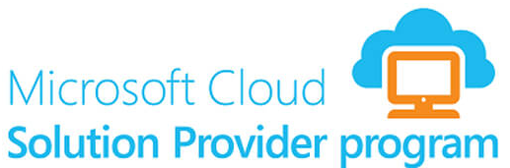
Additional Help
Assistance from MWH
MicroWarehouse is a value-added CSP distributor
We are available to:
  Sell with you
  Build with you
Contact us at sales@mwh.ie and buildwith@mwh.ie

Slide 26
Any Questions?
Thank-you for joining us
Alan Kinane
akinane@mwh.ie

