Slide 1
WFH
Backup as a Service BaaS
Mike Tonks UKI Hosting Manager
Notes:
This has been a great year for releases and updates..

Slide 2
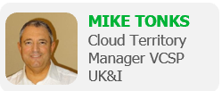
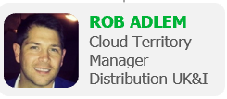
Veeam UK&I Cloud Team -2019
MARK ADAMS
Regional VP, UK&I
GREG BAILEY
Director — Channel & Cloud UK&I
GRAHAM CRICH
Director — Cloud EMEA
CATHERINE OLEFIRENKO
Internal Channel Manager UK&I
UKI Cloud & Hosting Team: CloudTeam.UK@veeam.com

Slide 3
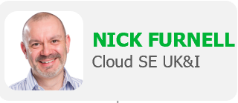
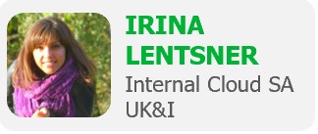
The Veeam Cloud Technical Team
LUCA DELL’ OCA
EMEA Cloud SA

Slide 4
VCSP - Why Veeam?
Notes:
This has been a great year for releases and updates..

Slide 5
Veeam Availability Platform
Monitoring & Analytics
Orchestration
Backup & Replication
DataLabs
Universal APIs
Cloud
SaaS
Physical
Virtual
Notes:
Platform purpose
Spheres represent those area where customers spawn data.
Format of data between our backup sources.
Physical and Virtual seen as 1 sphere – in the traditional DC space
SaaS – muse over the existing applications being adopted by our customers
Cloud – cross cloud, IN and OUT use cases

Slide 6
Veeam Breadth of Protection
Virtual
Physical
SaaS
Cloud
Notes:
VEEAM IS BEST POSITIONED FOR ACT 2
WE HAVE THE BROADEST BREADTH OF BACKUP SOLUTIONS

Slide 7
Veeam - The New Normal
Notes:
This has been a great year for releases and updates..

Slide 8
Veeam new normal: Land and expand
Old account growth model
The new normal for account growth
Market
Sell
Develop
Support
& Sell
Market
Sell
Install
Support
Offer
& Sell
Develop
Support
& Sell
Offer
& Sell
Market
Sell
Install
Support
Install
Market
Sell
Develop
Develop
Monetizable transactions
Monetizable transactions
Notes:
One of the biggest changes that has been driven by cloud is the change in the way that customers buys solutions. The days of large capital intensive projects are disappearing and I have spoken to an increasing amount of organisations that have stated that they will never make large upfront purchased again. Some of them still do but the trend is more towards an opex frienddy model. How this translates for partner selling to end users is that the first sale to a customer may not be the biggest. The aim is to get the first sale and prove the value and then start to expand to other services. Again go back to the previous slide about build longer lasting recurring revenue streams based on customer satisfaction.

Slide 9
The Data Protection Services Market
Notes:
This has been a great year for releases and updates..

Slide 10
81% of enterprises have a multi-cloud strategy
Key outcomes:
Increase innovation | Speed time to market | Optimize cost
Source: ESG, 2017 Public Cloud Computing Trends, April 2017
Notes:
In today’s digital economy customer expectations are increasing without a doubt. If you just look at how digital interactions have changed with the proliferation of smart devices, connected things, and digital commerce - from social media to online shopping to digital disruptors like AirBnB entering the market – it is clear that our businesses and IT infrastructures need to react in new ways.
To meet these rising demands, organizations are embracing a multi-cloud strategy to drive this innovation and change. In fact, based on recent studies 81% of enterprises have a multi-cloud strategy with a mix of private, public, and hybrid clouds. Enterprises are evaluating workload characteristics from mission critical applications and data to non-mission critical workloads to determine the right cloud fit to increase innovation, speed time to market, and optimize cost.

Slide 11
Backup & disaster recovery
For which of the following purposes does/did your organization use cloud infrastructure services?
#1
use case
Source: Enterprise Strategy Group
Notes:
I think every single survey I have seen over the last 10 years about cloud adoption has always had backup and DR as some of the key use cases driving the market. One of the great aspects about this is that these are fairly simple for the customer to adopt and fit with their standard way of thinking about IT. They have always had to plan for some form of off premise DR solution so cloud makes that much easier.
One of the big advantages for the cloud provider is once you have your customers data and can prove that you can manage that effectively it becomes easier to then sell more and more services to them.

Slide 12
BaaS – Why is BaaS uptake so high
Notes:
This has been a great year for releases and updates..

Slide 13
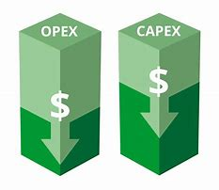
Uptake
There is no return on a backup investment
It is procured in the same was as insurance in case “something happens” a monthly bill
VCSPs provide this model

Slide 14
Backup as a Service - BaaS
Notes:
This has been a great year for releases and updates..

Slide 15
Definition
BaaS is not protection of an IaaS environment. IaaS supports production workloads requiring high performance infrastructure and compute. The backup element of this is part of the IaaS SLA.
BaaS is a services led engagement. It does not require high performance. Repositories can be on premise or in any type of cloud.

Slide 16
Building Block – Cloud Connect
Notes:
This has been a great year for releases and updates..

Slide 17
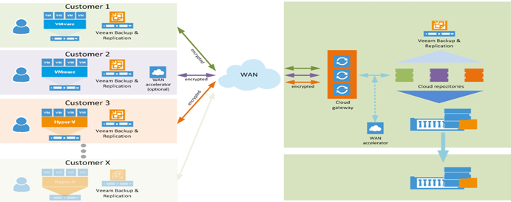
What is Cloud Connect?
Veeam Cloud Connect Backup (VCC-B) is a license required by a VCSP. The VCSP needs it to manage multiple BaaS environments on a single infrastructure

Slide 18
BaaS – Traditional Sell
Notes:
This has been a great year for releases and updates..

Slide 19
Cloud Connect and Total BaaS
Total BaaS Convert customers Veeam or Competitor perpetual license maintenance renewals to subscription
Veeam Cloud Connect Add Veeam Cloud Connect to existing / new Veeam customers

Slide 20
BaaS – VCSP New Commodity Sell
Notes:
This has been a great year for releases and updates..

Slide 21
VCSP Creates a per GB Cost
VCSPs – Cannot White-label services unless they are a commoditised
per GB Cost
+
=
Veeam SKU(s)
MSP per GB — Includes - Data-Centre, Compute Disk, Software, Networking and People costs

Slide 22
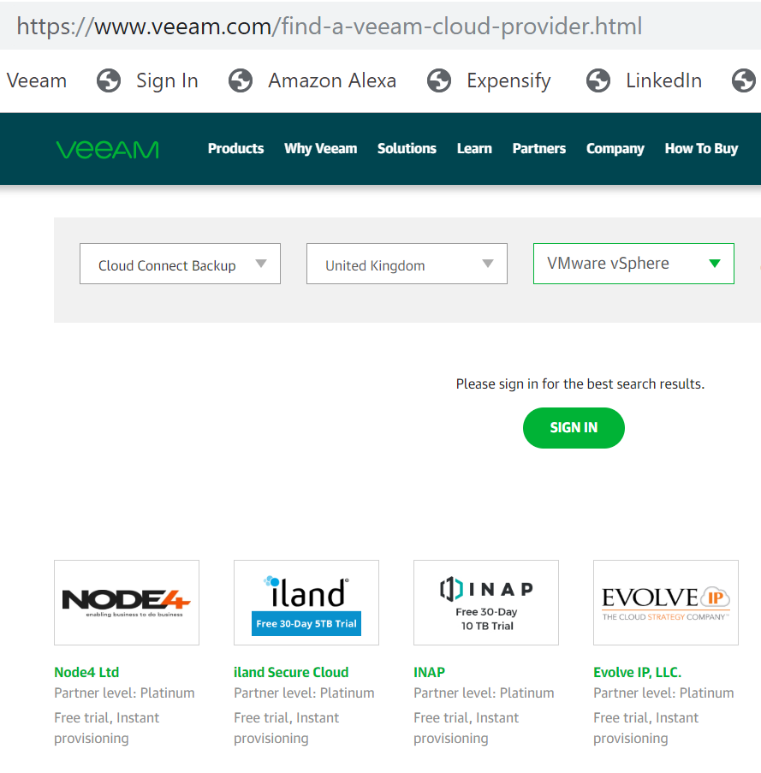
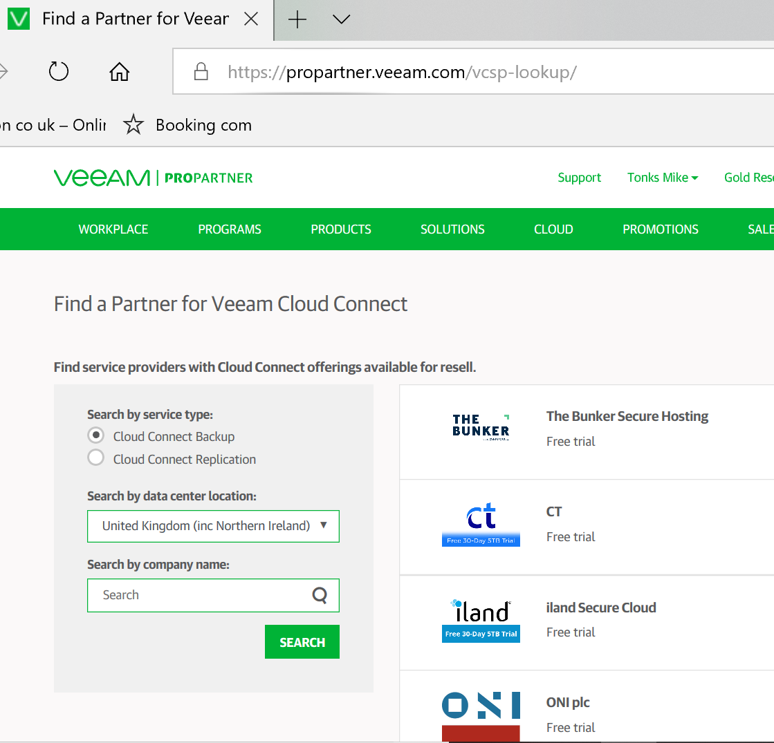
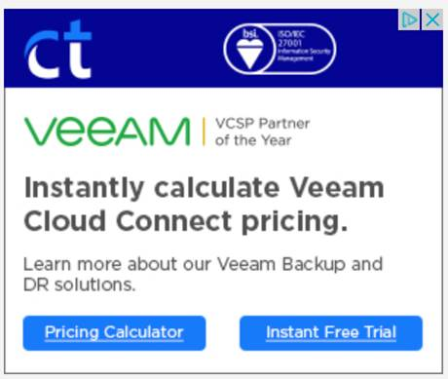
How VCSPs are Found
Veeam.com - End User
ProPartner - Partner Facing
Internet Banners – Public Domain

Slide 23
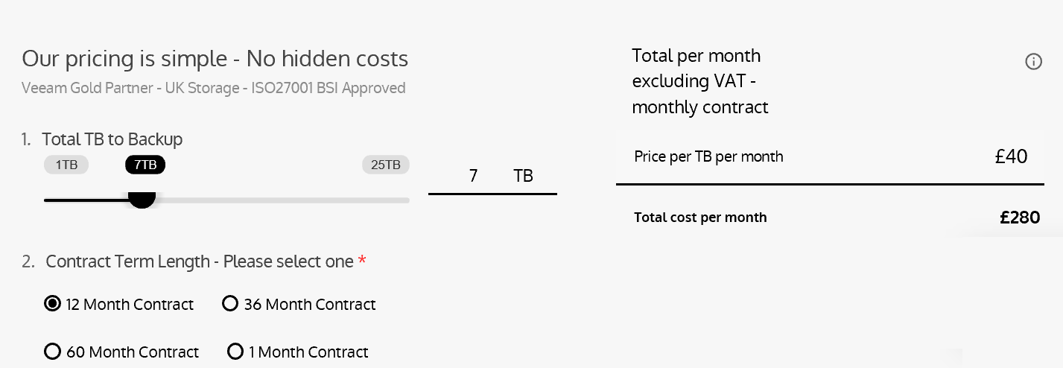
Example - Per GB Commodity Calculator

Slide 24
Lead Hits

Slide 25
WhiteSpace
Notes:
This has been a great year for releases and updates..

Slide 26
BaaS - Whitespace
Backup as a Service (BaaS) and Disaster Recovery as a Service (DRaaS)
Monitoring as a Service (MOaaS) and Software as a Service (SaaS) data protection
Cross-cloud
data protection/Migration as a Service (MaaS)
Backup
Offer a simple, reliable off-site backup to the cloud with Veeam, helping customers avoid data loss for their virtual and physical workloads.
Monitoring
Provides 24x7 real-time monitoring and alerting, resource optimization and configuration tracking reporting, capacity planning and forecasting insights, billing and chargeback, app-to-metal management on both Microsoft Hyper-V and VMware vSphere layers.
Cross-cloud backup/replication
Increasingly, customers want to leverage a multi-cloud strategy, and you can seize that opportunity by becoming the cross-cloud repository for applications and data hosted in any cloud — including workloads running in AWS, Microsoft Azure, IBM Cloud and more.
Disaster recovery
Capture the rising demand for DRaaS using fast, flexible failover / failback technology and a truly multi-tenant architecture. Veeam has the right tools to help you seize the market opportunity.
SaaS data protection
Customers want to be in control of their data. Offer off-site backup, self-service recovery and other data protection services to your SaaS customers, giving them the confidence to migrate their applications to the cloud.
Migration
Deliver data center transformation technology refresh or move to the cloud. Provide server and data center consolidation. Adhere to the rising demand for compliance mandates on data location. Deliver total data center relocation.
Data protection on premises and private, public and hybrid clouds — VMs, physical servers and workstations

Slide 27
White Labelling
Notes:
This has been a great year for releases and updates..

Slide 28
White labelling — The reselling of a service provided by a VCSP partner
Who benefits from white-labelling commoditised services:
Value-added resellers
Who do not sell cloud services
VCSP partners
Not offering a certain service; those who are supplying a white-label service
Veeamers
Introducing an end user, value-added reseller, VCSP partner to a VCSP partner they manage
Disti / Aggs
Introducing an end user, value-added reseller, VCSP partner to a VCSP partner they manage
VCSP partners who successfully white label grow more quickly and reduce their cost of sale!!

Slide 29
Routes to market for Veeam-powered services
The cloud is not one-size-fits-all, so it’s important to find the path that makes the most sense for your business. Here are four possible routes to the cloud market:
Refer
With a referral model, you’ll gain additional profit but also maintain an OpEx sales model
Resell
Add stability to your financials by adding top-line CapEx revenue AND increase the stickiness of your customer relationships
Brand (a white label service)
Maintain full control over your customer relationships but avoid the risks associated with standing up your own infrastructure
Host
Increase valuation by broadening your addressable market and maximizing profit margins with hosted Veeam-powered services
Notes:
SO we have now looked at the concept behind how we can partner and in the next section we will start to look at the specific services that we can build together.
But it doesn’t stop there.
We then need to decide on the best route to market for your offerings and the options are on the screen.
There is no right option and it is going to depend on your starting point as to which may be the best one.
You also need to look at your own capabilities and who are the existing strong partners in the market.
Whichever one of these you chose our VCSP program can help you to delvier and innovate.

Slide 30
BaaS - Qualification
Notes:
This has been a great year for releases and updates..

Slide 31
Per VM Backup as a Service
Do you already have Veeam ?
Veeam Cloud Connect Backup
5 points
YES
YES
Veeam Backup & Replication Enterprise Plus
13 points
Do you require self service?
NO
NO
Veeam Backup & Replication Enterprise
9 points

Slide 32
Cost Per Point

Slide 33
Thank you

